Slide 1
Formal Methods in Software Engineering
Concurrent Systems Modelling

Slide 2
Why model concurrent systems?
Distributed, concurrent systems are becoming commonplace, but they are diﬃcult to develop
  network applications, data communication protocols, multithreaded code, client-server applications
Concurrency – Specific errors: deadlock, livelock
  A deadlock occurs when the system has reached a state in which no work is done but at least one process in the system needs to complete its tasks
  A livelock occurs when the processes in a system are stuck in a repetitive task and make no progress towards their functional goals.
These types of behavioral errors can be mechanically detected if the systems are properly modeled and analyzed
5

Slide 3
Common ﬂaws in concurrent systems
Under-speciﬁcation: Model is incomplete, imprecise or allows behavior that should not be allowed (i.e., model is too permissive).
Over-speciﬁcation: Model disallows behavior that should be allowed, that is, model is to restrictive
Violations of safety properties: A safety property is a property that must not be violated
  “nothing bad should happen”; a bad behavior should never occurs
  An invariant is an example of a safety property
  Example 1: Mutual exclusion property – at most one process is in its critical section at any given time
  Example 2: Absence of deadlocks:
Violations of liveness properties: Set of properties that a system must satisfy, i.e., properties that require desired events eventually occur
  “something good eventually happens”
  Example 1: Starvation freedom (e.g., each process waiting to enter its critical section will eventually enter its critical section.
  Example 2: Progress: A process will eventually perform a non-skip step

Slide 4
Using Transition Systems to model System Behavior
A Transition System (TS) is a directed graph where nodes represent states and edges represent transitions between states
A state describes information about a system at a particular point in time
– e.g., the state of a traﬃc light indicates the color of the light that is illuminated at a point in time
A transition describes the conditions under which a system moves from one state to another.

Slide 5
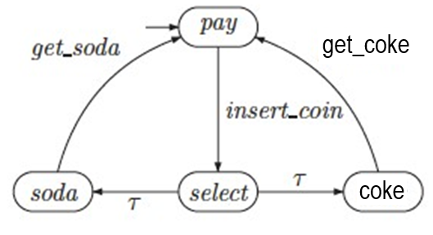
A (toy) example of a simple TS
Transitions are associated with action labels that indicate the actions that cause the transition.
insert_coin is a user action
get_soda, get_coke are actions performed by the machine
τ denotes an activity that is not of interest to the modeler (e.g., it represents an internal activity of the vending machine)

Slide 6
Examples of Concurrent Systems
Daily Life Applications
  Railway Networks (note shared sections of track)
  Machines in a factory
  Banking systems; ATM Network;
  Travel reservation systems
  Multiplayer games
  Well coordinated teams or societies
  The Brain – the Mind
Hardware examples:
  A single processor can have multiple execution pipelines (but only one set of registers)
  A processor can have multiple cores (multicore)
  A computer can have multiple processors
  A network can have multiple computers
  An internet has multiple networks

Slide 7
Examples of Concurrent Systems
Multiprogramming, or running a lot of programs concurrently (the O.S. has to multiplex their execution on available processors). For example:
  downloading a file
  listening to streaming audio
  having a clock running
  chatting
  analyzing data from some weird experiment
  streaming a movie
  printing something
  running a simulation
  typing in a text editor
  running a web server, sendmail, and other daemons
Simulation programs

Slide 8
Examples of Concurrent Systems
Many algorithms can be broken up into concurrent parts:
Mergesort
Quicksort
Summing a list by summing fragments in parallel
Operating on independent slices of an array

Slide 9
Using transition systems to model concurrent behavior

Slide 10
Concurrent systems
A concurrent (parallel) system consists of multiple processes executing concurrently (in parallel).
If a concurrent system consists of n processes, in which each process, proc_{i}, is modeled by a transition system TS_{i}, the concurrent system can be modeled by a transition system
TS = TS₁ || TS₂ || … || Ts_{n}
– where || is a parallel composition operator

Slide 11
Types of parallel composition operators
Interleaving (for Independent Processes)
  Actions of concurrent processes are interleaved in a non-deterministic manner
  Used to model processes whose behaviors are completely independent (asynchronous system of processes)
Communication via shared variables (for Shared variable Processes)
  A process can inﬂuence the behavior of another process by changing the value of a variable that is shared with the process
Handshaking (for Shared Action Processes)
  Two processes that want to interact must synchronize their actions such that they take part in the interaction at the same time
Channel systems
  In a channel system processes interact by reading from and writing to channels connecting them

Slide 12
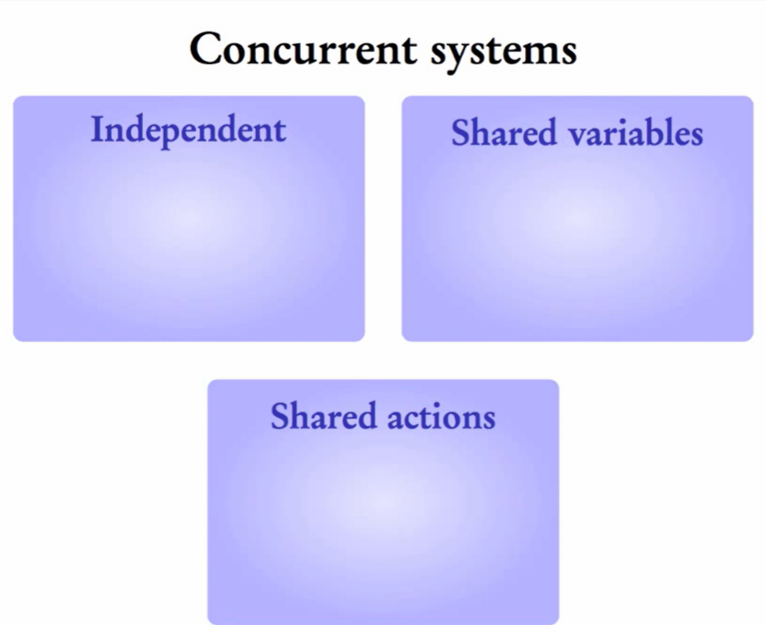

Slide 13
Interleaving

Slide 14
Interleaving of processes
When processes can execute in a completely independent manner (with no interactions) one can view the system of processes as one system consisting of the actions of each process merged (interleaved) in an arbitrary manner
– In this system concurrency means that the order in which the actions are performed does not aﬀect the ﬁnal result; i.e., P1.act1;P2.act2 produces the same result as P2.act2;P1.act1, where Pi.acti is an action performed by process Pi (i=1 or i =2)
The interleaving view is an abstraction in which only one processor is assumed available to execute the processes

Slide 15
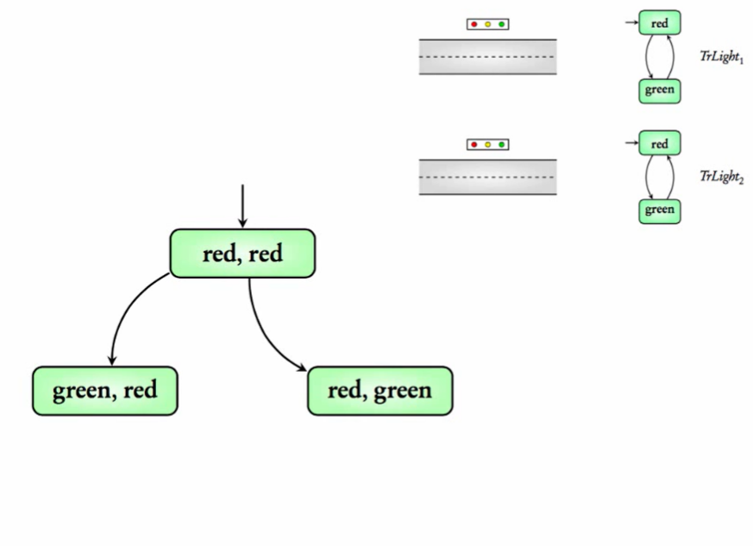

Slide 16
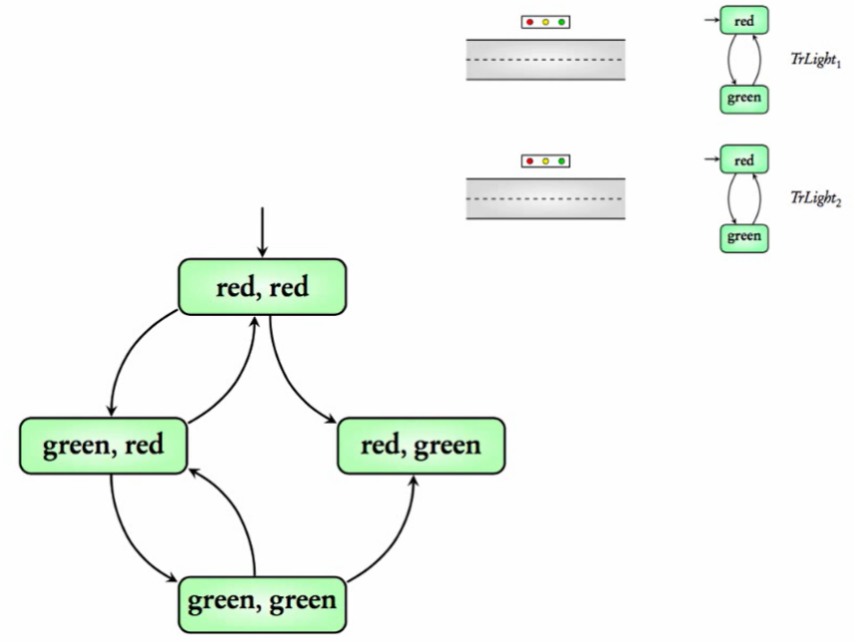

Slide 17
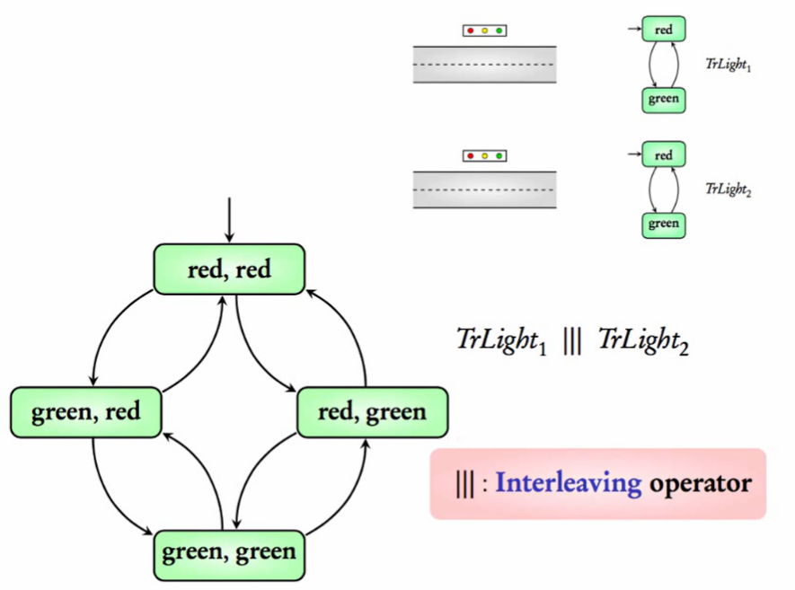

Slide 18
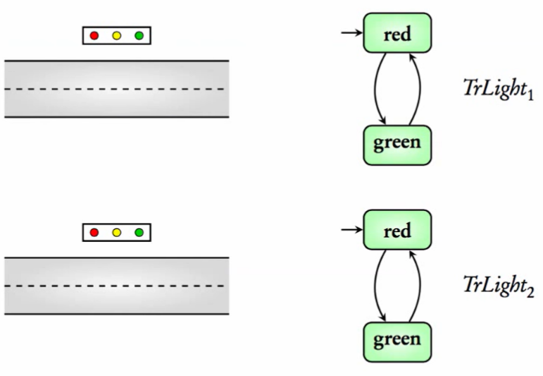
Interleaving of Traﬃc Light Transition Systems
Consider a system with two traffic lights, each modeled by a transition system

Slide 19
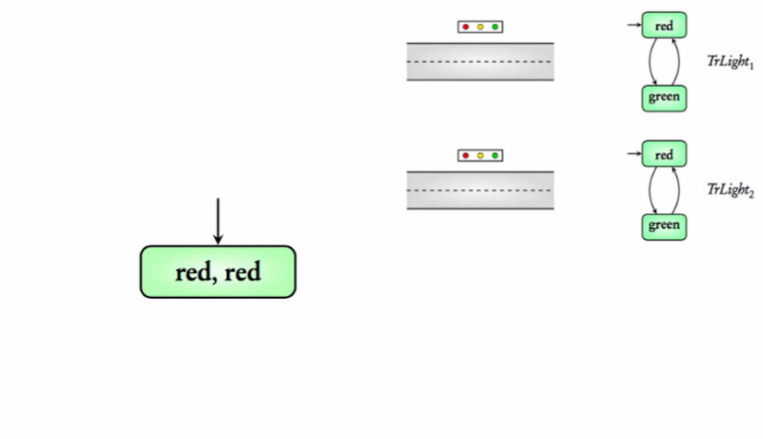

Slide 20
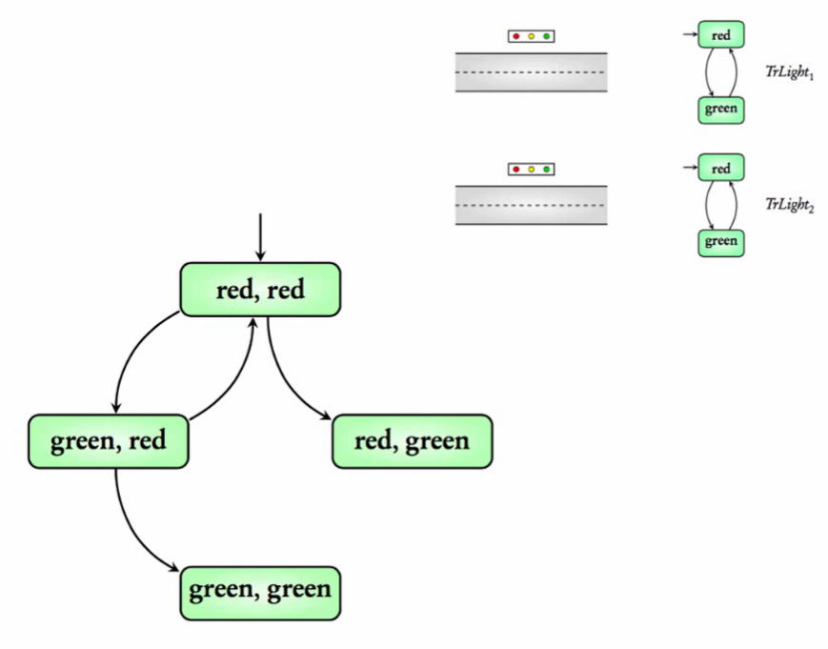

Slide 21
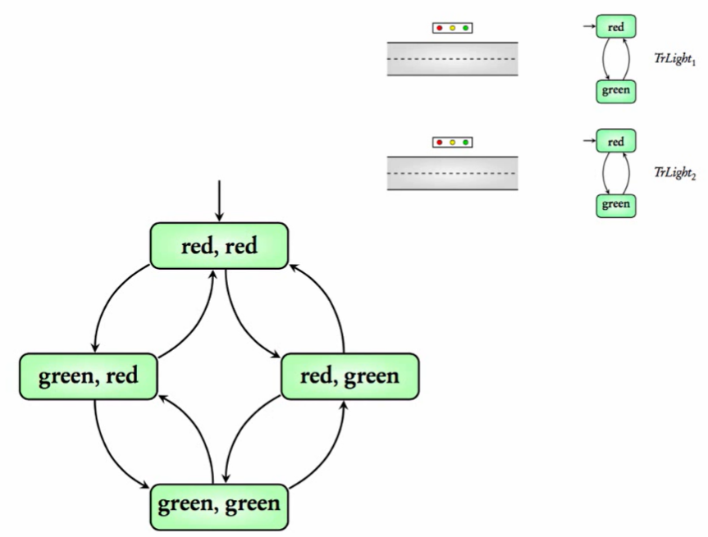

Slide 22

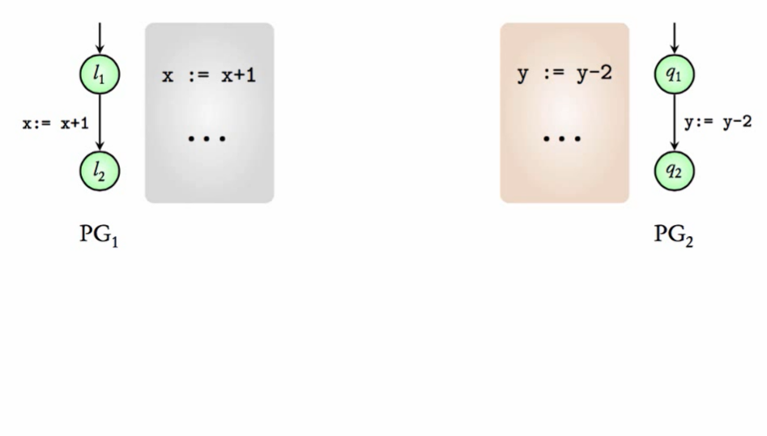
Eﬀect of an interleaving operator: An example
Note that variables are not shared across processes

Slide 23
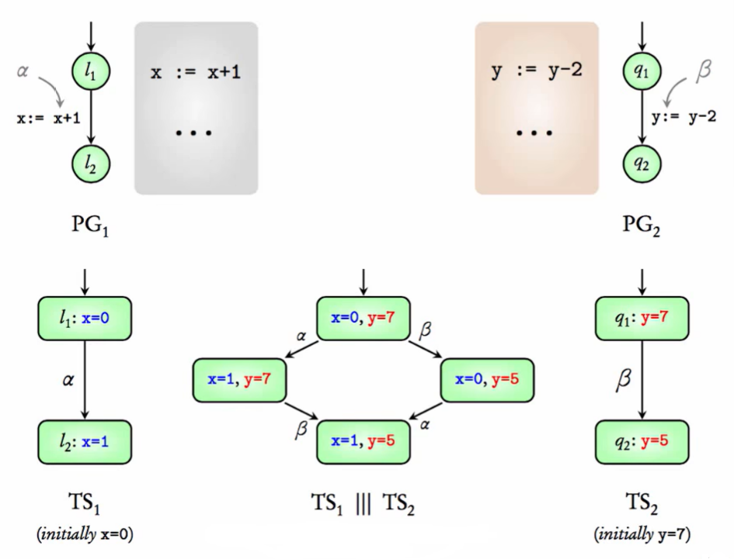

Slide 24
Eﬀect of an interleaving operator
The above states that the order in which the actions α, β are performed does not matter.
||| is the interleaving operator
; is sequential composition
+ represents non-deterministic choice

Slide 25
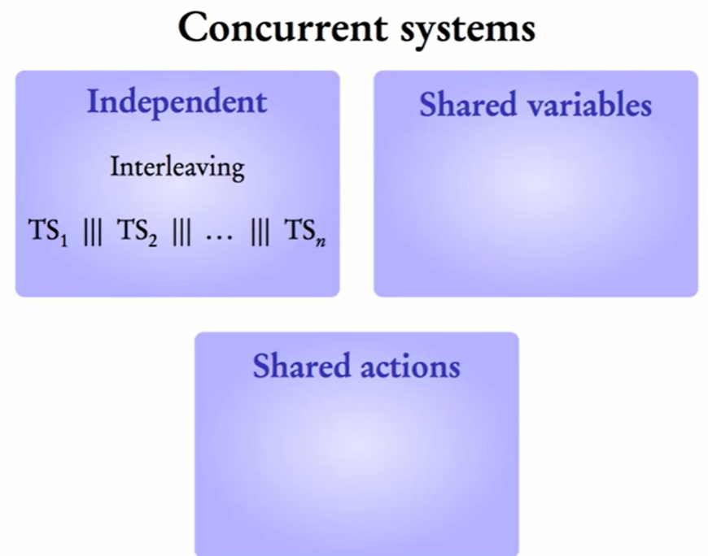

Slide 26
Communication via Shared Variables

Slide 27
Modeling non–asynchronous systems
Interleaving operator requires that processes are completely independent
What happens if processes access data that is globally accessible (global data)?

Slide 28
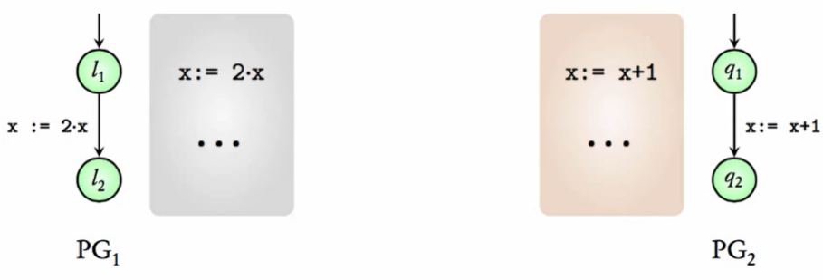
Interleaving in the presence of shared variables
Consider the program graph describing 2 actions from 2 processes, PG1, PG2, that access a global variable x (locations are omitted to simplify the presentations)
α: x := 2 * x
β: x := x + 1
(α ||| β) = (x := 2 * x ||| x := x + 1)

Slide 29
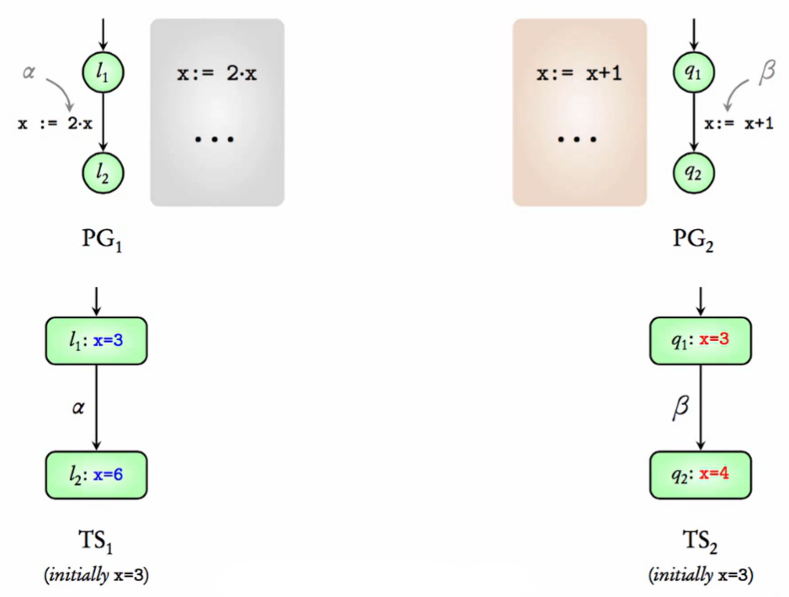

Slide 30
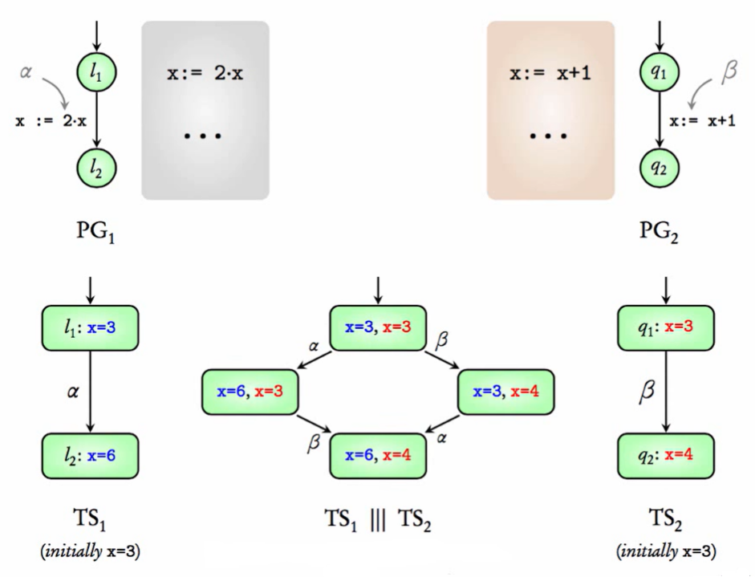

Slide 31
Modeling processes that access global variables
An interleaving operator, |||, on program graphs (rather than transition systems) is used
– PG1 ||| PG2
TS(PG1 ||| PG2) describes a TS that treats shared variables appropriately
In general,
– TS(PG1 ||| PG2) ≠ TS(PG1) ||| TS(PG2)

Slide 32
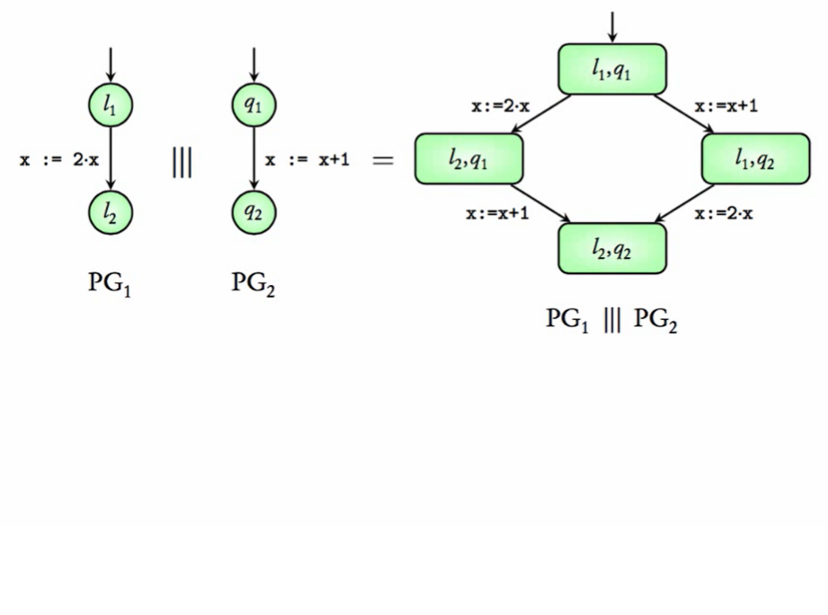

Slide 33
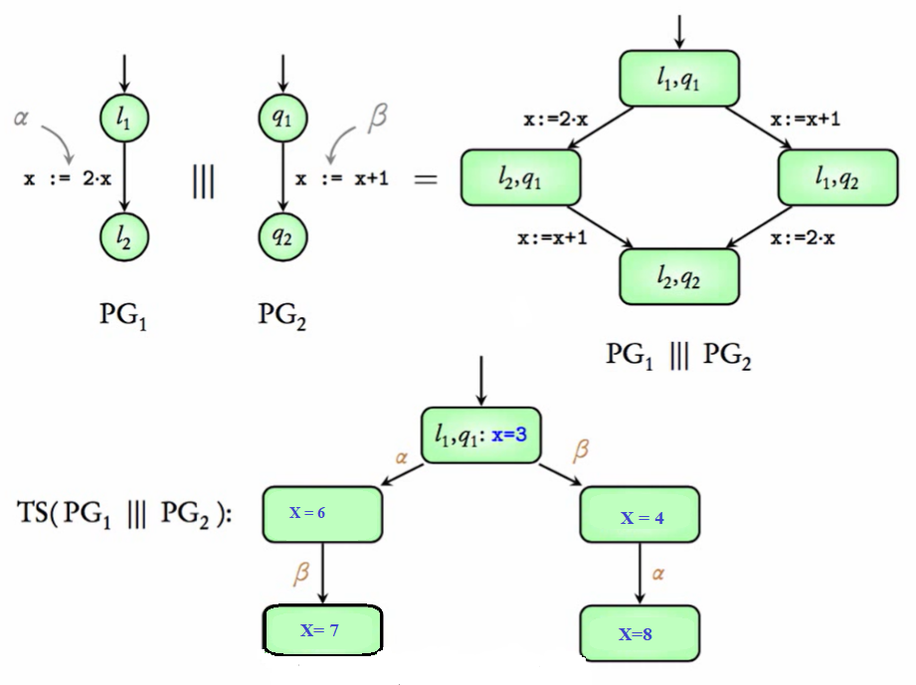

Slide 34
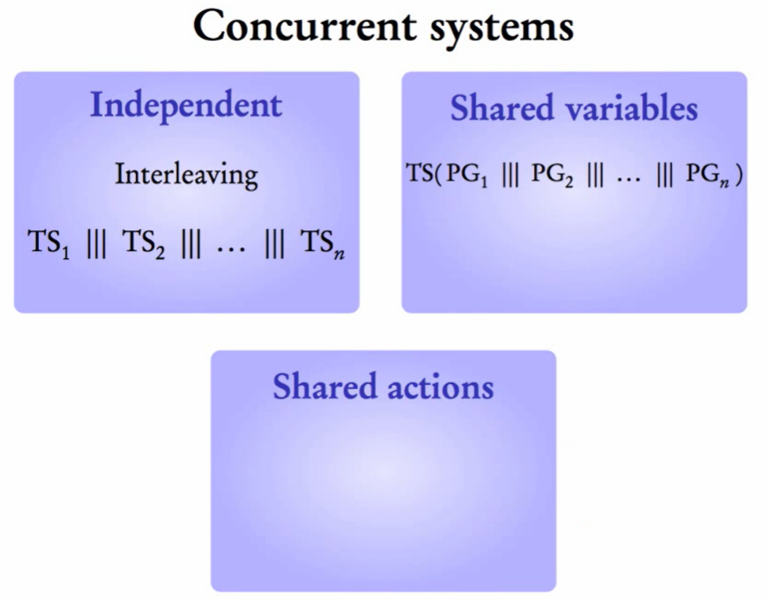

Slide 35
Handshaking

Slide 36
Synchronous interactions
Processes can also interact through a set of synchronizing actions, H, called handshake actions
Processes interact only if they all can perform the same handshake action at the same time
  i.e., the models must “shake hands” for the interaction to take place
These actions may involve the transfer of data
  This transfer will be ignored in the models we
consider, i.e., we are interested only in the occurrence of the handshake and not in the data that is exchanged

Slide 37
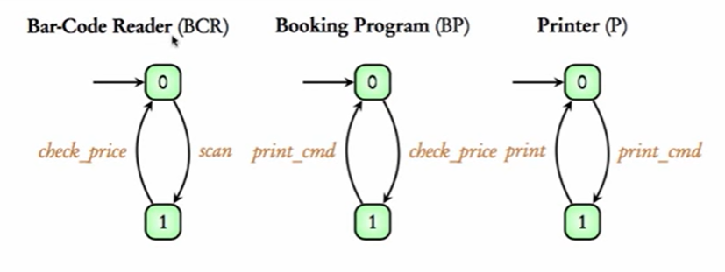

Slide 38
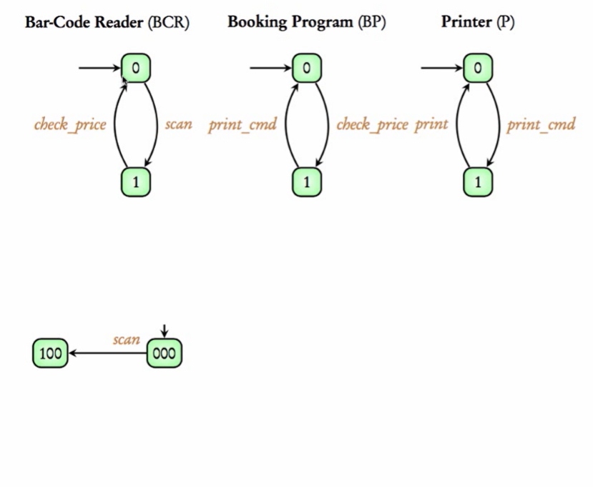

Slide 39
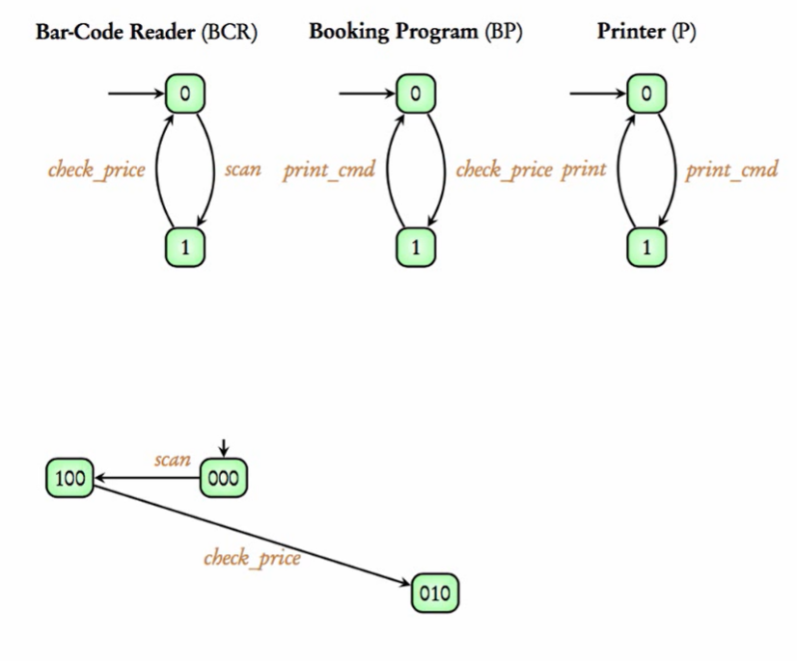

Slide 40
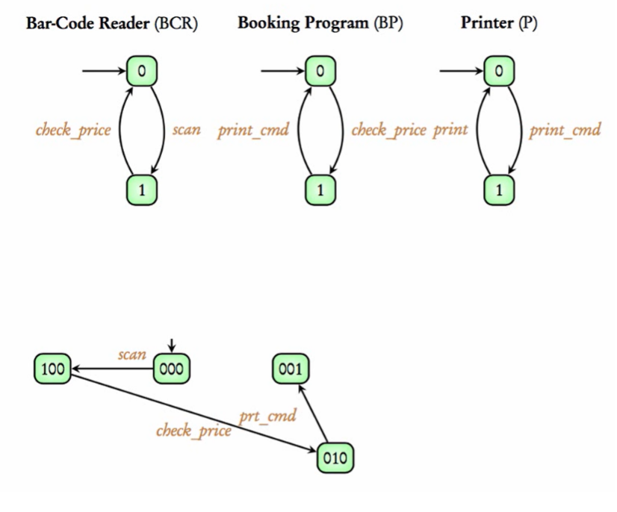

Slide 41
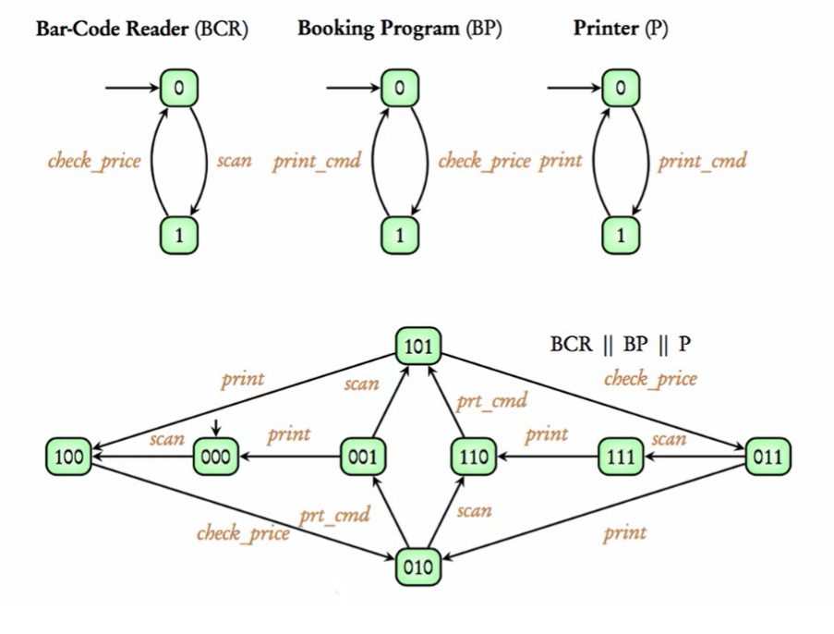

Slide 42
Handshaking Forms
Empty set of handshake actions reduces to interleaving

Slide 43
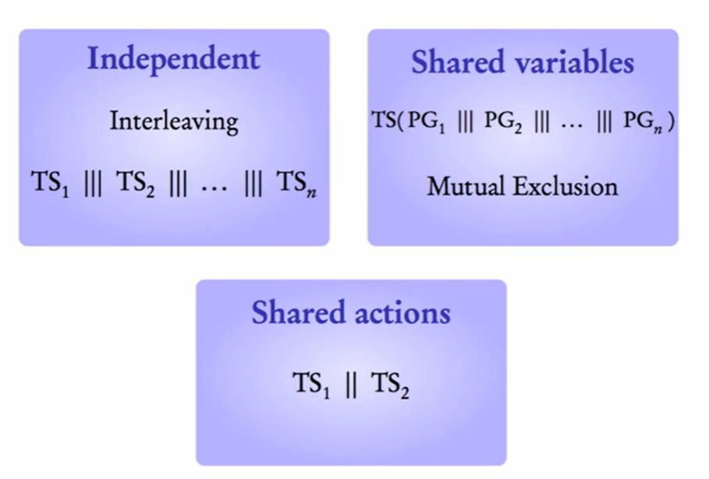

Slide 44
Channel Systems

Slide 45
Asynchronous message passing
Processes interact by passing information to each other via channels of ﬁnite or inﬁnite capacity
– A channel is like a buﬀer
System thus consists of processes and channels
If channel capacity > 0 the processes do not need to wait for a response from receiver when sending a message
If channel capacity is 0 then this form of interaction reduces to handshaking
Each channel can accept messages of a speciﬁed type only

Slide 46
Communication actions
Processes can perform the following communication actions:

